Slide 1

JP Morgan Code for Good 2017: Ocean’s Daughter Conservation Alliance
GROUP 8: Junior Recinos, Sanjeeth Bhat, Rachel Klesius, David Sherrier, Rahul Kant, Sreejhit Chidarala

Slide 2


Our Solution to the challenge
FinFun - An android based game
Educates children through positive reinforcement
Presents a challenging and engaging game mode
Unlockables to keep the attention of children
Accessories, in-game powers, backgrounds
Accessible with minimal need for the Internet

Slide 3





Technical Architecture
Software: Android Studio, Adobe Photoshop,
Languages: Java, XML
Tools: GitHub, Bash Scripting, FireBase

Slide 4
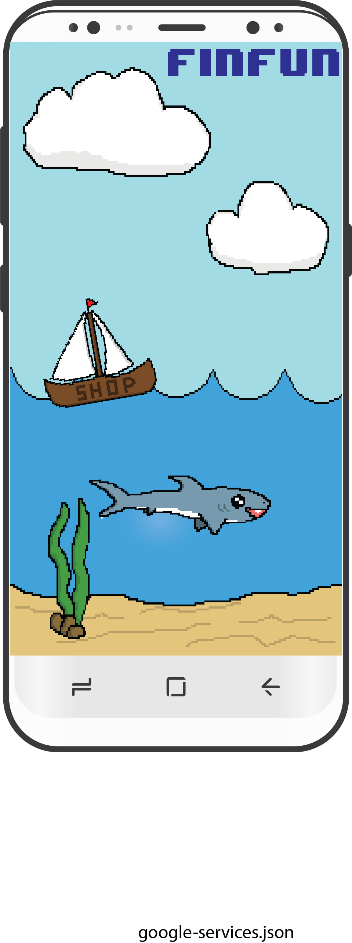
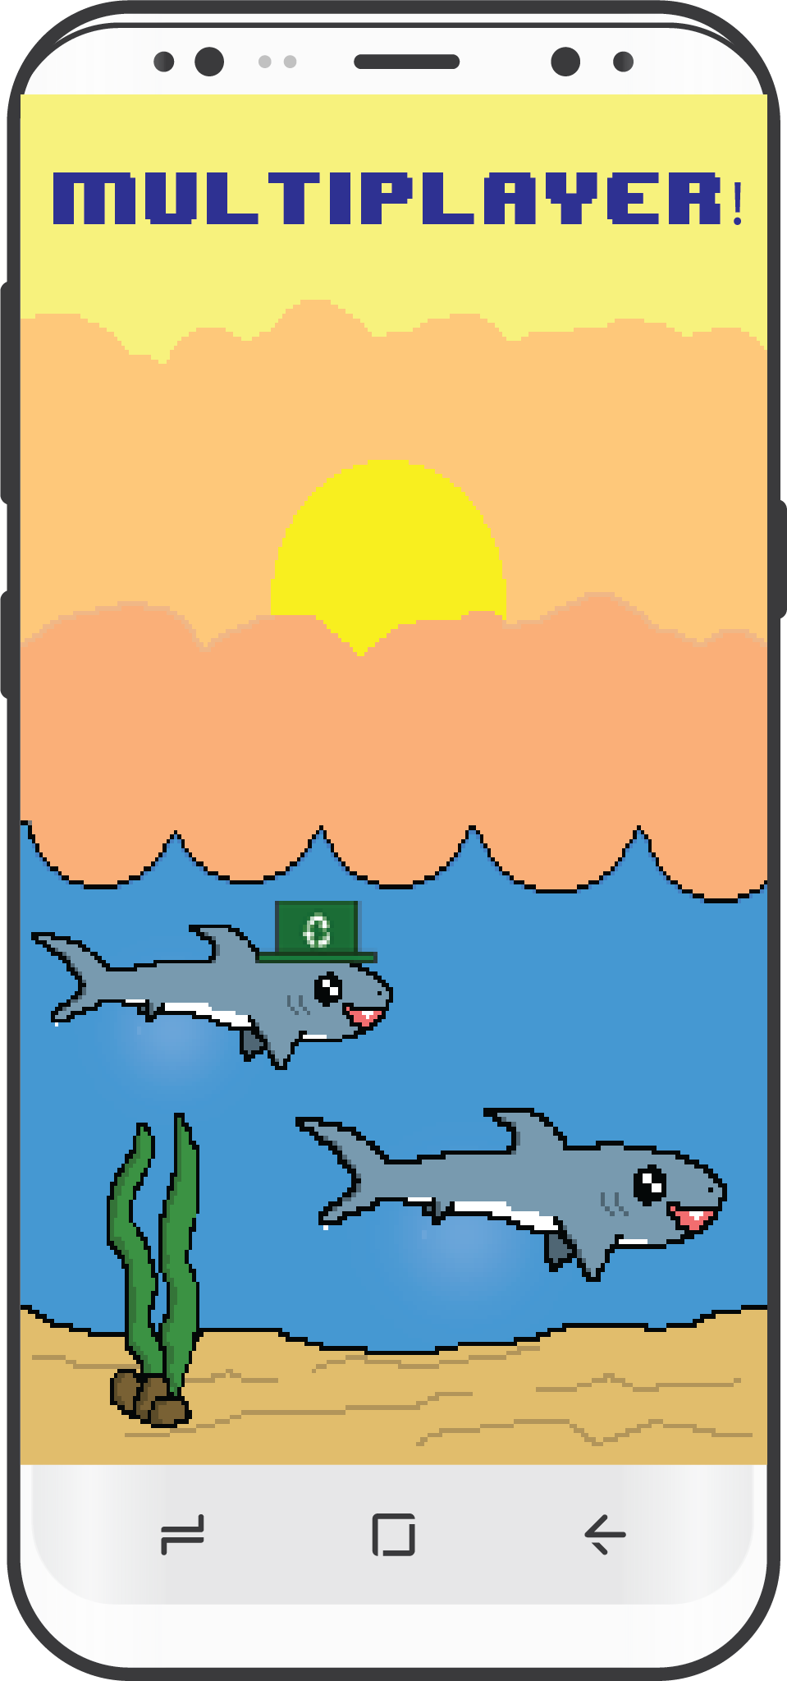
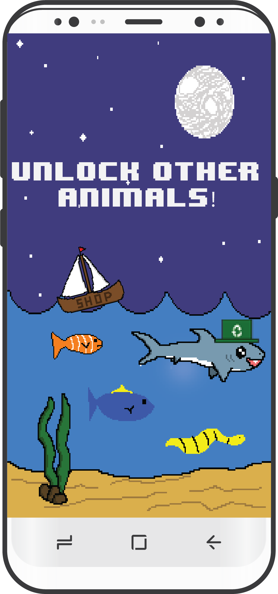
Future Capabilities

